Slide 1
Screening for Order Parameter Redundancy
Pavan Ravindra

Slide 2
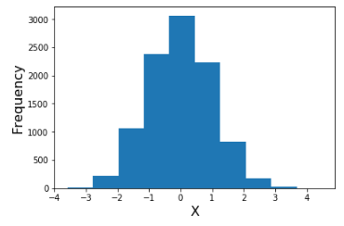
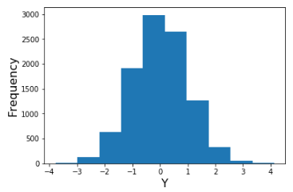
Order Parameter Selection
Biophysical knowledge or intuition
Redundancy not always obvious

Slide 3
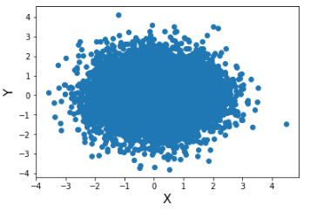
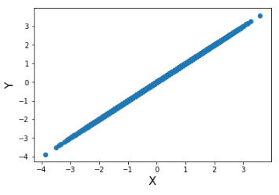
Answer?
Vs.
You would need to look at joint distribution for every pair of OP’s!
Always inconvenient, sometimes impossible

Slide 4
Formal Description of Problem
Given: set of order parameters (and their trajectories)
Return: smallest set of order parameters that still describes system
Essentially, we want to screen for redundant order parameters
Small-scale: Given set of 12 order parameters, how many of these do we actually need?
Large-scale: Given 500 order parameters, how many capture different degrees of freedom?

Slide 5
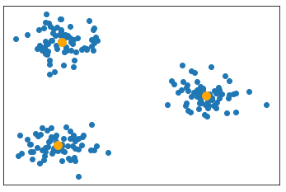
Overview of Approach
Cluster OP’s in some meaningful space
Select a single OP from each cluster
Return best set of OP’s
Problems:
No identifiable low-dimensional OP space
Number of clusters

Slide 6
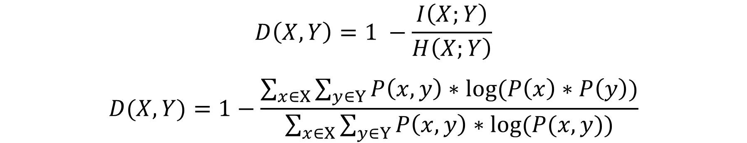
Mutual Information Based Distance Function
$$D\left(X,Y\right)=1 −\frac{I\left(X;Y\right)}{H\left(X;Y\right)}$$
$$D(X,Y)=1−\frac{\sum_{x∈X}{\sum_{y∈Y}{P\left(x, y\right)∗log⁡(P\left(x\right)∗P\left(y\right))}}}{\sum_{x∈X}{\sum_{y∈Y}{P\left(x, y\right)∗log⁡(P(x,y))}}}$$
Symmetric: D(X,Y) = D(Y,X)
Normalized in range [0, 1]
Small distances: large difference between joint distribution and independence assumption
Large distances: Joint distribution is similar to independent OP’s

Slide 7
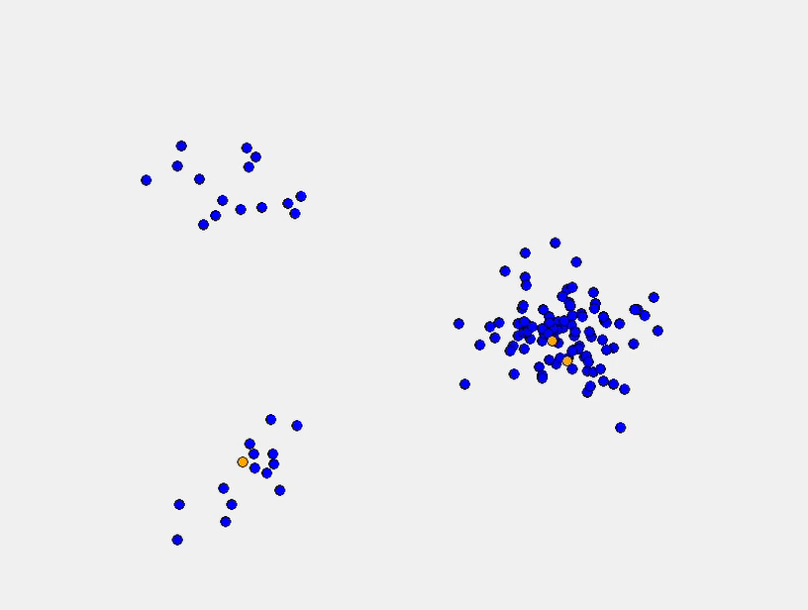
Requirements of Clustering in this System
Centroids must be in the original data set
Non-element centroids are physically meaningless
Initial randomized centroids can get stuck in the same cluster

Slide 8
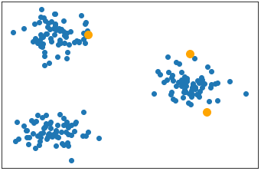
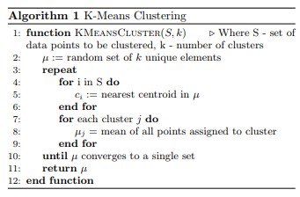
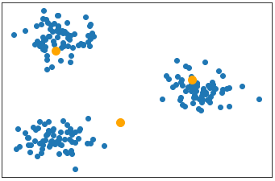
K-Means Clustering
Groups a set of data points into some provided number k clusters
Initial centroids in same space as S
Centroids are flexible (not in S)
Move from one cluster to another

Slide 9
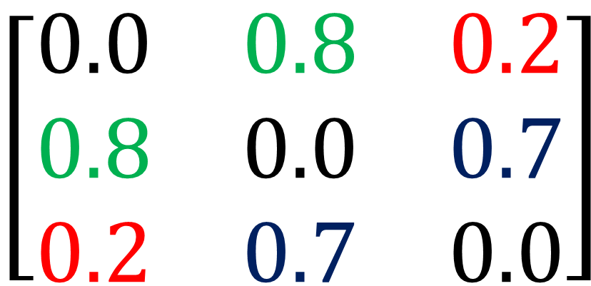
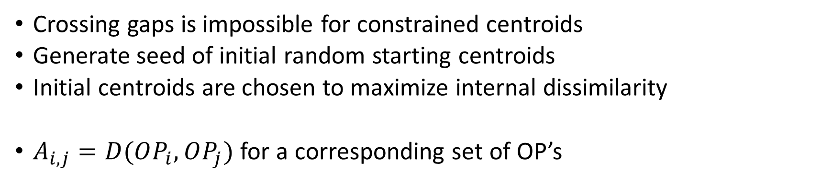
Dissimilarity Matrix
Crossing gaps is impossible for constrained centroids
Generate seed of initial random starting centroids
Initial centroids are chosen to maximize internal dissimilarity
$A_{i,j}=D(OP_{i},OP_{j})$ for a corresponding set of OP’s
$$\left[\begin{matrix}0.0 & 0.8 & 0.2 \\ 0.8 & 0.0 & 0.7 \\ 0.2 & 0.7 & 0.0\end{matrix}\right]$$
Interesting Properties:
Main diagonal is all 0’s:
D(X, X) = 0
Dissimilarity matrix is symmetric:
A_{i,j} = D(I, J) = D(J, I) = A_{j,i}
Product of a row (without diagonal):
Dissimilarity with entire set

Slide 10
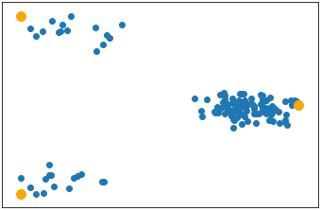
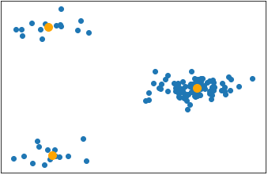
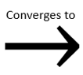
New Starting Point for Clustering
Initial centroids are selected to start far apart
Starting centroids ARE NOT good at describing entire system
For proper k, centroids do not need to cross gaps

Slide 11
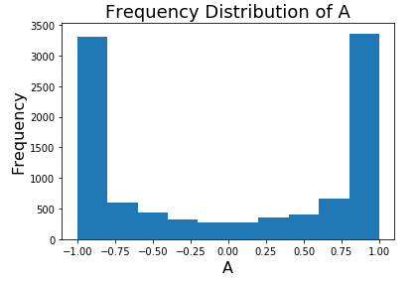
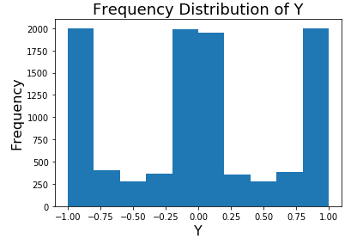
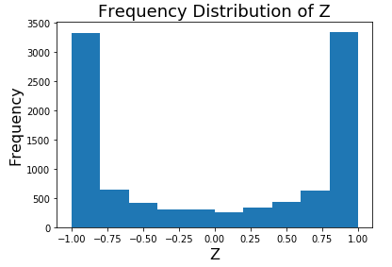

Model System
Description of Order Parameters:
5 independently sampled random variables (A, B, X, Y, and Z)
Scalar multiples of these original OP’s
$$2A, −5B, 7Y$$
Linear combinations of original OP’s
$$W=10A+B−3Z$$
Original OP with noise added
$A_{3}=A+i_{3}$ for $i_{3}∈[−0.05, 0.05]$

Slide 12
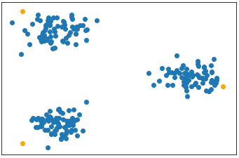

Model System (Results)
Dissimilarity matrix output (k = 5):
$A_{1}$
$B_{3}$
$X_{3}$
$Y_{3}$
$Z_{1}$
Important Note:
OP’s are dissimilar
These OP’s do not best describe system

Slide 13

Model System (Results)
Clustering starting with prior seed of OP’s (k = 5):
$2A$
$−2B$
$X$
$5Y$
$Z$
Original 5 sampled values (success!)

Slide 14
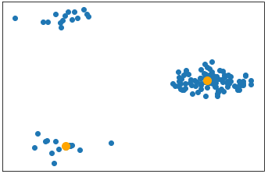
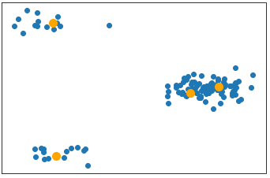
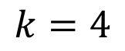
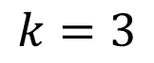
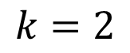
Progress?
What we have:
For a given number k, we can find the k best OP’s to describe entire set of OP’s
What we don’t have:
A robust method of determining the best k for a set of OP’s
$$k=2$$
$$k=3$$
$$k=4$$

Slide 15


Rate Distortion Theory
Distortion function:
In Euclidean space, RMSD of distances to closest cluster
$$d=1+\sqrt{\sum_{x∈S}{{\left(D\left(x,c_{x}\right)\right)}^{2}}}$$
where $c_{x}$ is the closest centroid to $x$
Dimensionality (p) of arbitrary space is unknown
$d_{eff}≤10$
Catherine A. Sugar
“Jump Method”
Evaluate “distortion” for each k
Raise distortions to a negative exponent Y:
$Y=−\frac{p}{2}$
Look for largest jump

Slide 16
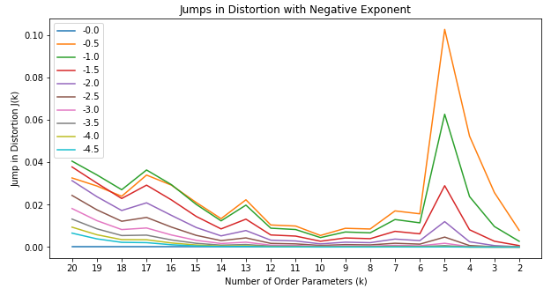
Back to Model System
Clear jump at k = 5 consistent for all choices of Y

Slide 17
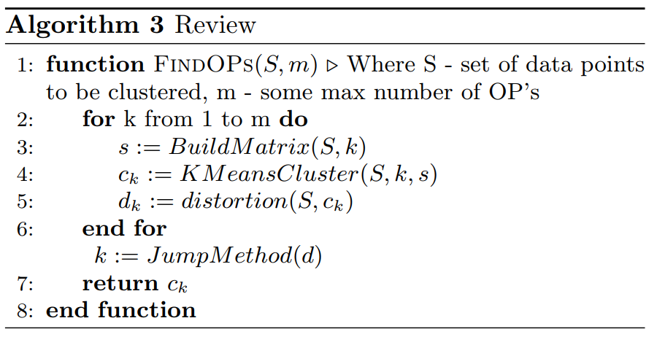
Review of Entire Algorithm

Slide 18
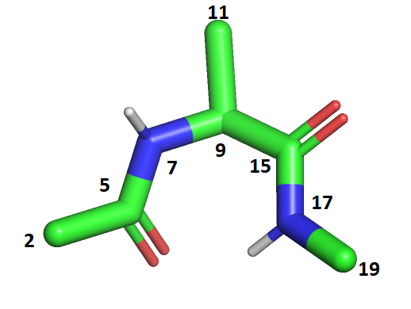
Alanine Dipeptide
Phi: 5,7 – 9,15
Psi: 7,9 – 15,17
Redundant Dihedrals
5,7 – 9,15
Distances:
2 -> 17
2 -> 19
11,9 – 15,17

Slide 19
FKBP/BUT Protein-Ligand System
107 amino acids (alpha carbons) in protein
4 carbons in ligand
4 * 107 = 428 initial order parameters
Use these 428 OP’s in bound trajectory as input to algorithm:
8 output order parameters
d134_1666
d327_1664
d575_1667
d960_1667
d1238_1664
d1321_1667
d1328_1666
d1631_1666

Slide 20
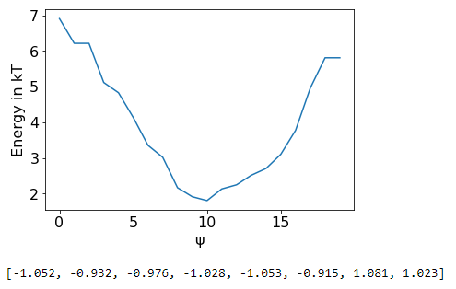
Results of SGOOP (Bound Phase)

